Slide 1
Final Project: Earthquake Alert Prediction Model
CSCI 3360
Name: Sach Shrestha
Fall 2025

Slide 2
AGENDA
Introduction
1
Motivation
2
Dataset Features
3
Initial Analysis
4
First Model: Decision Tree
5
Results I
6
Improving the Model
7
Second Model: Random Forest
8
Results II
9
In Comparison
10

Slide 3
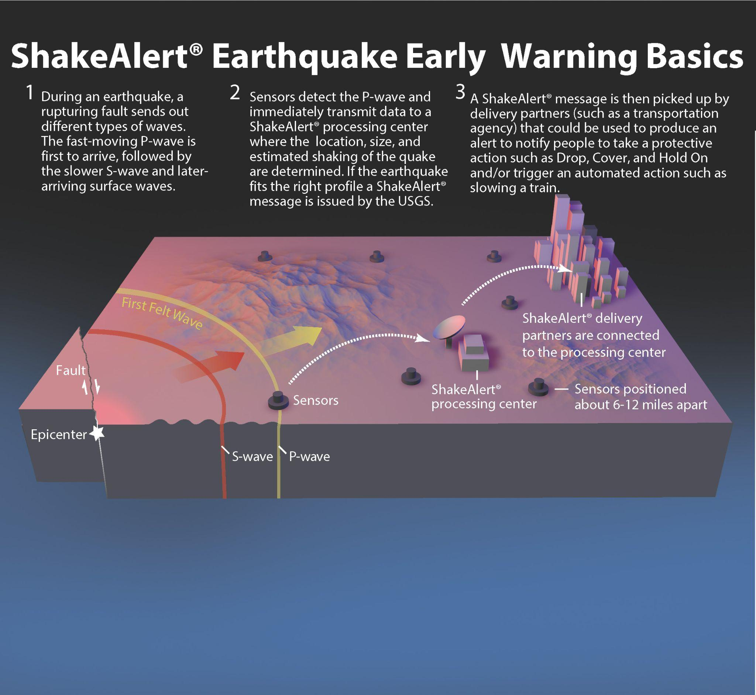
Earthquake Alert System
INTRODUCTION
Not about “predicting” earthquakes
Sensors can detect early signs of earthquakes
Data collected from those sensors is used to issue an appropriate alert for residents in the area
Aim: Predicting the correct alert label
https://www.usgs.gov/media/images/earthquake-early-warning-basics-0

Slide 4
MOTIVATION
“Whether or not Earthquake Early Warning systems can provide useful (i.e., timely and correct) alerts before earthquake shaking begins at a site depends on numerous factors. The hardest hit sites tend to be the ones that are the most difficult to alert because they are typically located close to the epicenter, where the seismic waves arrive first. Sites that are farther away from the epicenter can potentially receive longer warning times, but in these places the alerts may be less important because the shaking is weaker.
In this study we run three prominent Earthquake Early Warning algorithms retrospectively on 219 of the largest earthquakes in Japan. We analyze how often and under what circumstances the algorithms can provide useful warnings. We put special emphasis on the challenging sites that receive high shaking intensities. We find that all algorithms can alert a significant fraction even of these difficult cases.”
Meier, M., Kodera, Y., Böse, M., Chung, A., Hoshiba, M., Cochran, E., Minson, S., Hauksson, E., & Heaton, T. (2020). How Often Can Earthquake Early Warning Systems Alert Sites With High‐Intensity Ground Motion? Journal of Geophysical Research: Solid Earth, 125(2). https://doi.org/10.1029/2019jb017718
‌

Slide 5
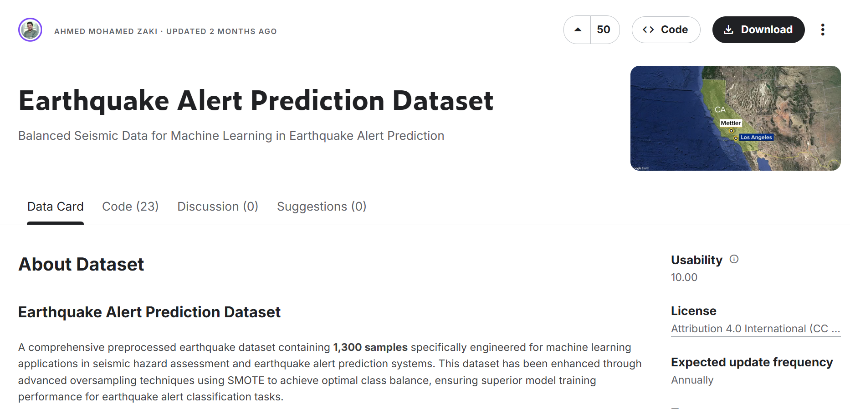
DATASET
https://www.kaggle.com/datasets/ahmeduzaki/earthquake-alert-prediction-dataset/data

Slide 6
1
2
3
4
5
Magnitude
Depth
CDI
MMI
Sig
The Magnitude of the earthquake (Richter Scale)
The depth where the earthquake begins to rupture (km)
The maximum reported intensity for the event range
The maximum estimated instrumental intensity for the event
A comprehensive significance measure determined by multiple factors including the other features
Higher values indicate more significant seismic events
Can be negative
6
DATASET FEATURES
Alert
Categorical earthquake alert level classification
(Target Variable)

Slide 7
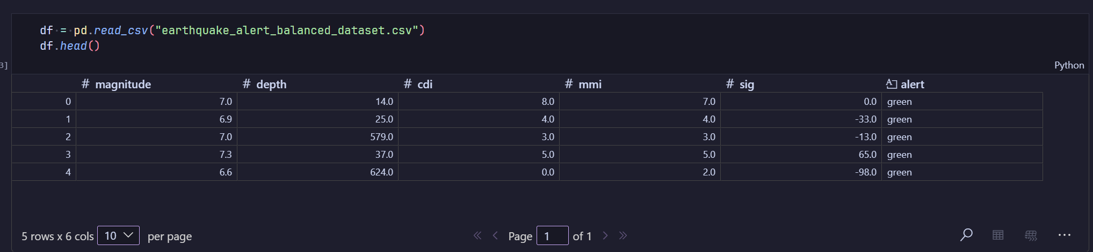
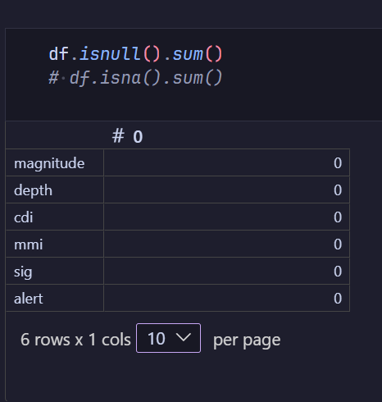
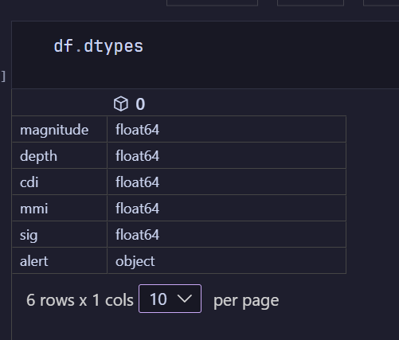
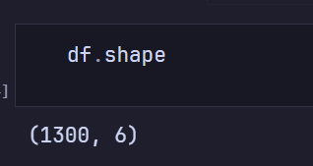
INITIAL ANALYSIS

Slide 8
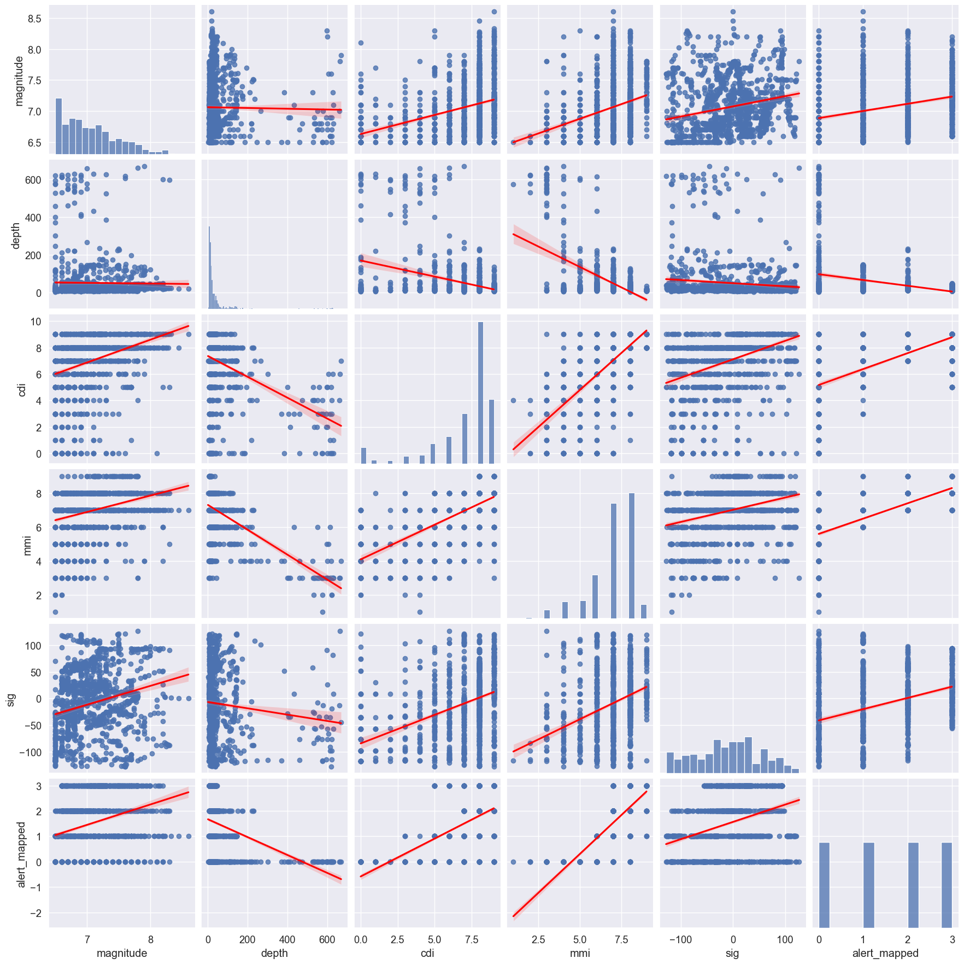
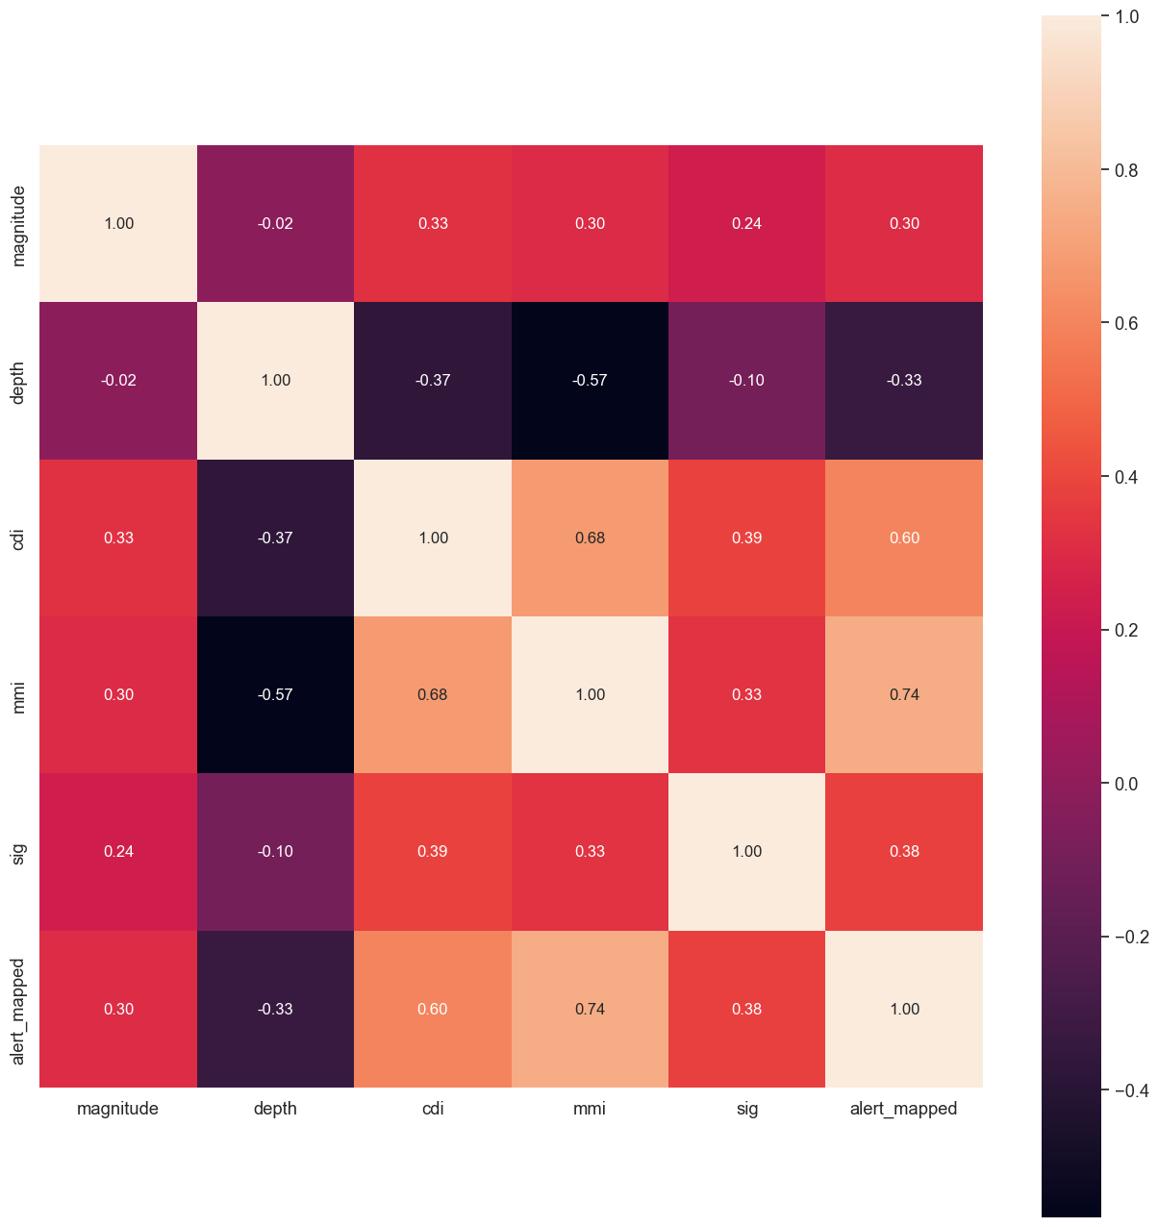
INITIAL ANALYSIS

Slide 9
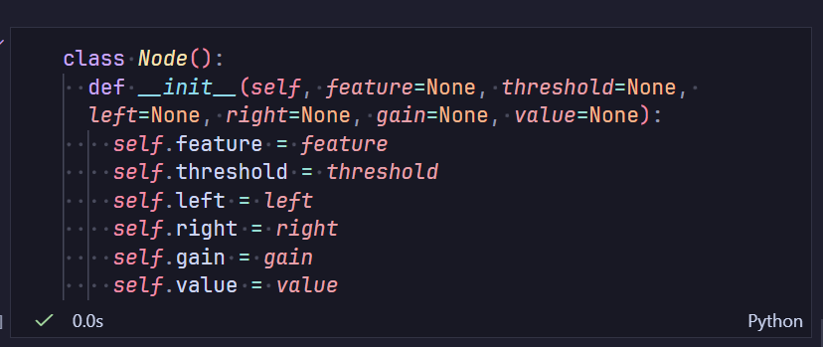
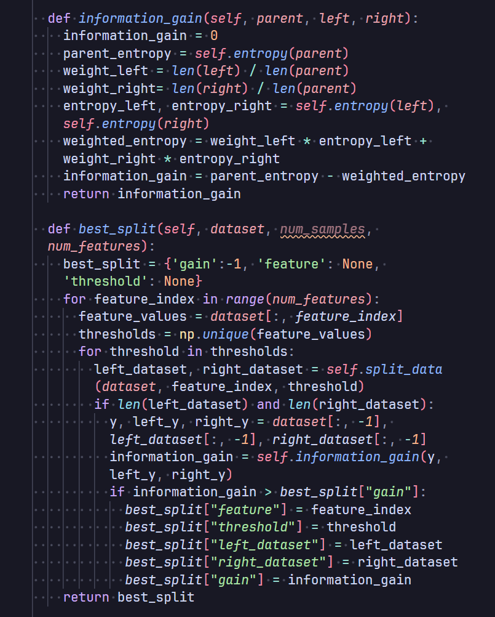
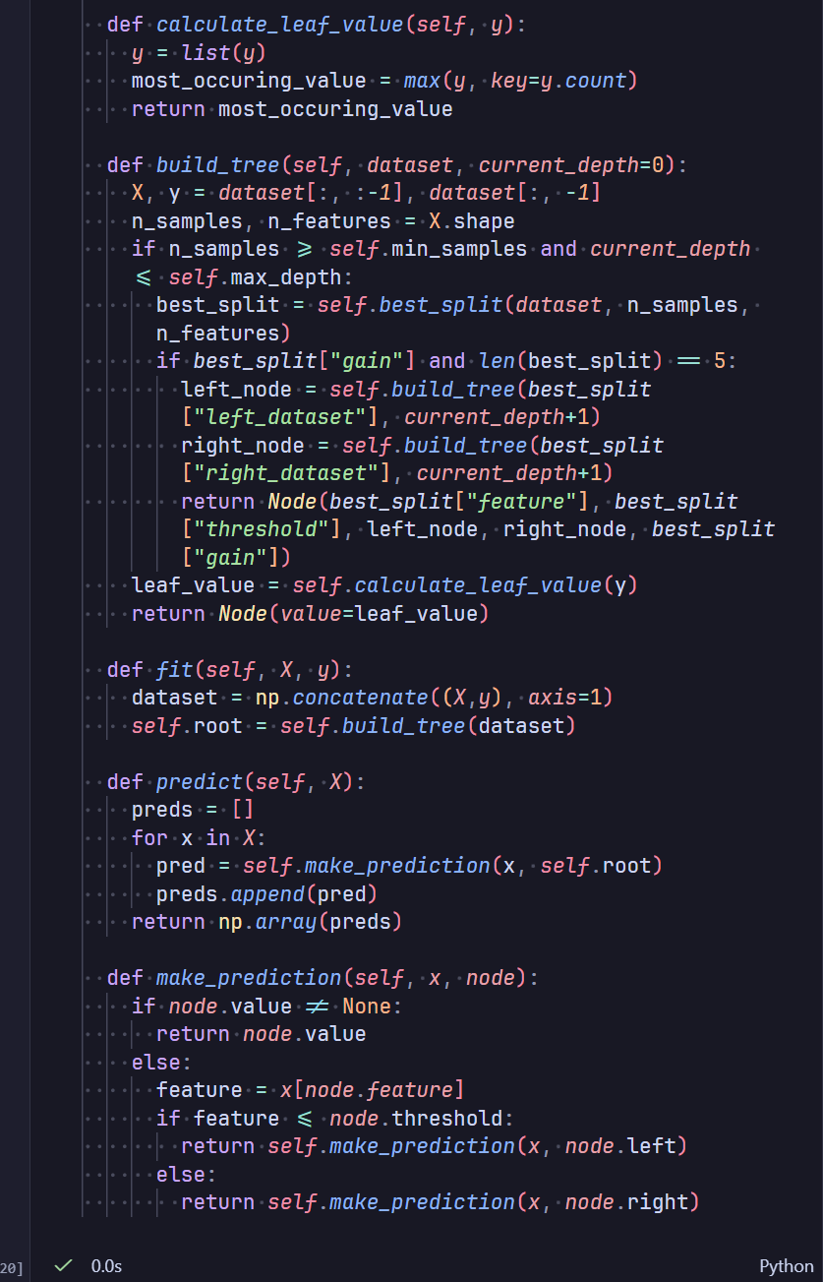
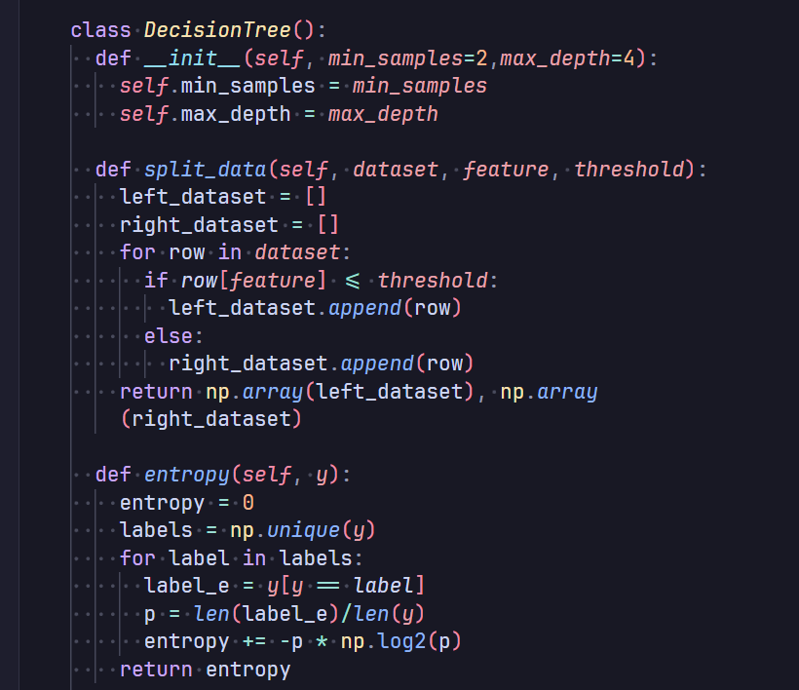
First Model: Decision Tree
MODEL #1

Slide 10
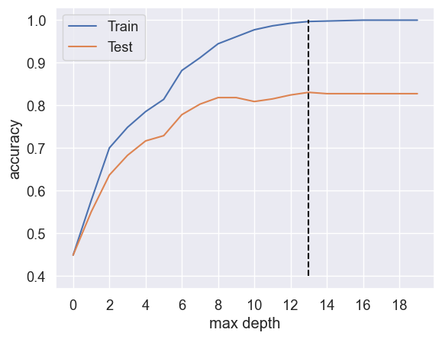
Decision Tree: Results + Improvement
MODEL #1
Base model parameters: min_samples=2, max_depth=4
Training Accuracy = 78.6%
Testing Accuracy = 71.7%
To improve the model, I tested different max_depth values. The ideal max_depth value was found to be 13.
Updated model parameters: min_samples=2, max_depth=13
Training Accuracy = 99.7%
Testing Accuracy = 83.1%

Slide 11




This is the most performance we can squeeze out this singular decision tree. We could also try different splitting criterion like Gini Impurity to see if it performs better. Instead, the method of improvement I chose to implement was…
FURTHER IMPROVEMENT

Slide 12
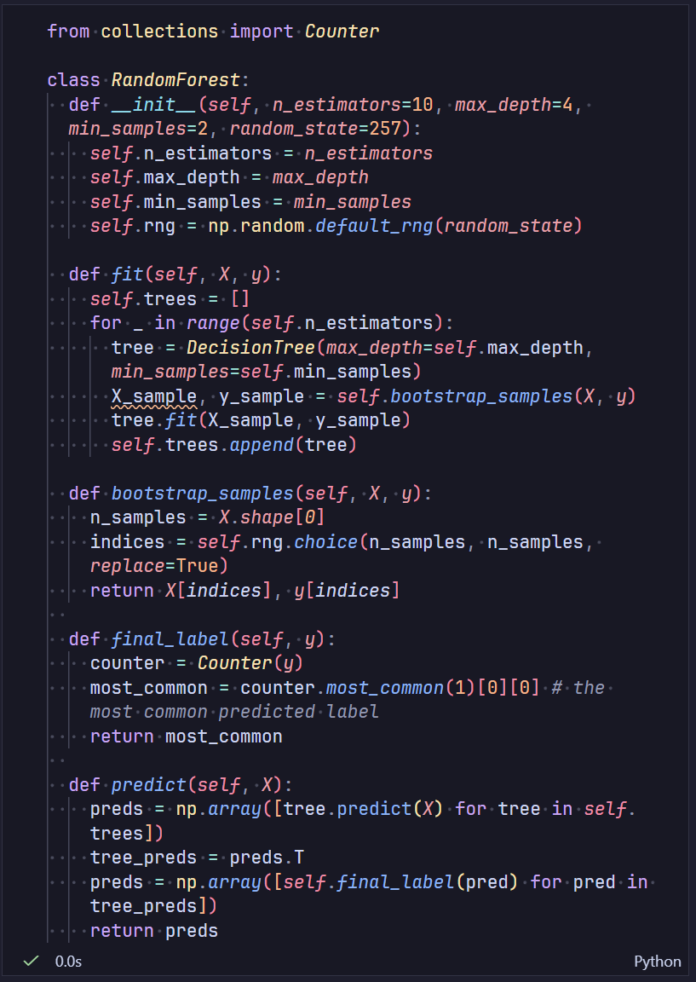
Second Model: Random Forest
MODEL #2
To improve performance further, I implemented a Random Forest Classifier using the previous decision tree as its base.
This Random Forest ensemble method uses Bootstrap Aggregating (Bagging) to sample from the training set.
This model has 2 additional parameters:
n_estimators: The number of decision trees in the forest
random_state: The random state seed for bagging to get reproducible results during testing

Slide 13
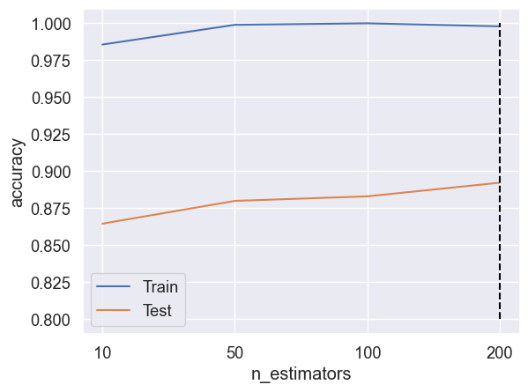
Random Forest: Results + Improvement
MODEL #2
Base model parameters: min_samples=2, max_depth=13, n_estimators=10, random_state=42
Training Accuracy = 98.6%
Testing Accuracy = 86.5%
The ideal n_estimator value was found to be 200.
Updated model parameters: min_samples=2, max_depth=13, n_estimators=200, random_state=42
Training Accuracy = 99.8%
Testing Accuracy = 89.2%

Slide 14
COMPARISON
In Comparison
Random Forest (n_estimators=200)
KNN (k=3)
Support Vector Classifier
Logistic Regression
Training
91.6%
77.8%
65.5%
99.8%
Testing
84.9%
72.9%
68.0%
89.2%
sklearn base models

Slide 15
Thank you!
CSCI 3360
Contact ss37550@uga.edu

